Slide 1
Ace Digital
Technical Assessment Q1

Slide 2
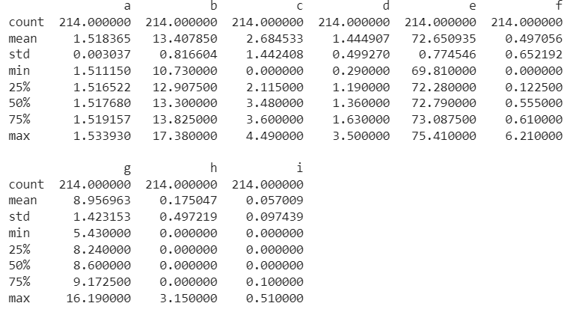
Additive Studies
The purpose of this study is to verify the formula are significant different.
The dataset consists of 214 formula samples, each containing 9 additives.
No missing data is present in the dataset.

Slide 3
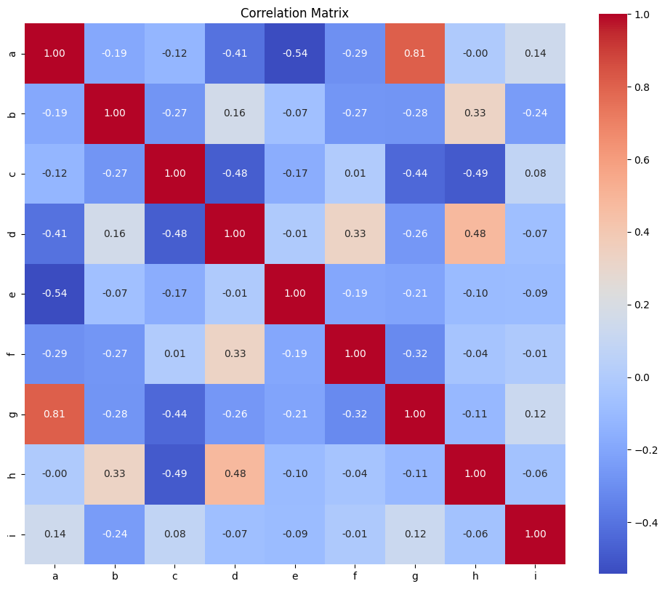
Correlation Matrix
A correlation matrix is plotted to identify additive that are highly correlated with each other.
Additive A is highly correlated with additive G and additive E.
Highly correlated features might lead multicollinearity issue.
To further prove it, a Variance Inflation Factor (VIF) test is conducted.

Slide 4
VIF Test
Additive | VIF
A | 0.895
B | 0.984
C | 0.995
D | 0.961
E | 0.983
F | 0.977
G | 0.995
H | 0.962
I | 0.179
The VIF is calculated for each independent variable by regressing it against all other independent variables in the model.
Generally, VIF values above 5 or 10 are considered high, indicating a strong correlation between the variables.
By referring to the right table, most of the additive have VIF value of more than 5.
Proving multicollinearity problem is true.

Slide 5
Handling Multicollinearity
Although Multicollinearity is a concern primarily in regression analysis, a dataset with multicollinearity can also be a problem to clustering analysis.
If multicollinearity is severe and causes highly correlated variables to dominate the clustering process, it can lead to biased results or an emphasis on a subset of variables.
In this studies we are do perform clustering analysis to determine the distinctive number of formulations present in the dataset.
In such cases, it may be beneficial to address multicollinearity before clustering.
In this study, PCA is used to handling this issue.

Slide 6
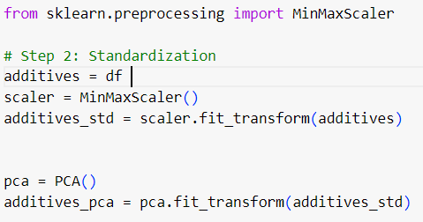
Principal Component Analysis (PCA)
PCA is primarily used for dimensionality reduction and capturing the most significant patterns in the data.
PCA transforms a set of potentially correlated variables into a new set of uncorrelated variables called principal components.
By using these uncorrelated components instead of the original correlated variables, we can reduce the impact of multicollinearity in subsequent analyses.

Slide 7
PCA Component
Component | Cumulative Explained Variance
1 | 0.454
2 | 0.634
3 | 0.761
4 | 0.859
5 | 0.927
6 | 0.969
7 | 0.996
8 | 0.999
9 | 1
According to table at the right, the first five component generated by PCA can explain 90% of the original 9 features.
So we are going to use the first five component as the input for the clustering analysis.

Slide 8
Clustering Analysis
In order to determine the distinctive number of formulations present in the dataset. Hierarchical Clustering has been applied to the dataset.
K-means clustering is sensitive to the initial selection of cluster centroids, which can lead to different results in different runs. Hierarchical clustering, on the other hand, is less sensitive to initialization because it does not depend on initial centroids.
Other than that, Hierarchical Clustering is more superior in irregularly shaped clusters.
K-means assumes that clusters are spherical and have similar sizes, as it minimizes the within-cluster sum of squares.
While Hierarchical Clustering can handle irregularly shaped clusters by capturing the shape and connectivity of the clusters more effectively.

Slide 9
Distinctive Number of Formulations
Silhouette score has been used to determine the most optimal number of cluster.
The Silhouette score ranges from -1 to 1, with values close to 1 indicating a good match to the assigned cluster and separation from others,.
While values close to -1 suggest a potential misassignment to the wrong cluster.
The average Silhouette Score has peak at 3 and drop significantly starting from 4, indicate the optimal value is 3 cluster.
After apply the model to the dataset, cluster 0 become the largest cluster with 162 samples.
Optimal n Cluster | Avg Silhouette Score
2 | 0.535
3 | 0.540
4 | 0.324
5 | 0.338
Cluster | Number of Sample
0 | 162
1 | 31
2 | 21

Slide 10
One Way ANOVA Test for Additives
Additive | P- Value
A | 5.29351715e-15
B | 1.83277439e-20
C | 4.66608571e-85
D | 5.60140464e-25
E | 5.71527693e-01
F | 3.02637942e-01
G | 2.34981892e-36
H | 2.50261408e-32
I | 1.15805453e-02
Analysis of variance (ANOVA) has been performed to determine if there are significant differences among the formulations based on the additives.
ANOVA will help assess whether the variations in the additives' levels across different formulations are statistically significant.
Based on the result of ANOVA test, most of the additive have a P Value of below 0.05 except for additive E and F.
Indicate only additive E and F has no significant different in these 3 cluster.

Slide 11
One Way ANOVA Test for Main Component
Analysis of variance (ANOVA) has been performed on main component generated by the PCA too.
ANOVA will help assess whether the variations in the additives' levels across different formulations are statistically significant.
Based on the result of ANOVA test, all main component have a P Value of below 0.05
Indicate all the main component of the formulative from the 3 cluster are significantly different.
Main Component | P-Value
0 | 3.48616300e-89
1 | 1.54118082e-26
2 | 1.16101485e-02
3 | 1.06796422e-04
4 | 8.65945787e-04

Slide 12
Conclusion
Based on the ANOVA test for additive and major component of the formula. It prove that the formulations are significantly different

Slide 13
Graphical Analysis

Slide 14
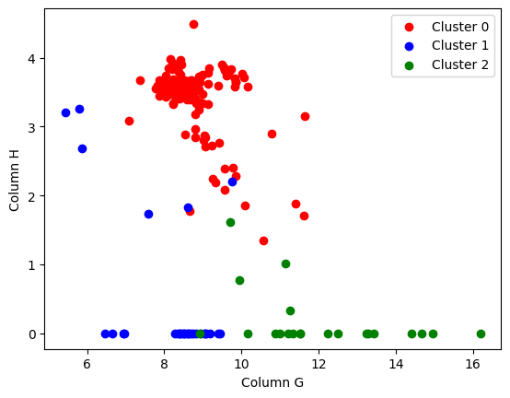
Distribution of Additive G and H
Additive G and Additive H are among the lowest P-value compare to other additive.
By plotting a plot chat, we can notice Cluster 0 has High Value in Additive H and Medium in Additive G.
Cluster 1 has low value of Additive G while Cluster 2 has high value of Additive G

Slide 15
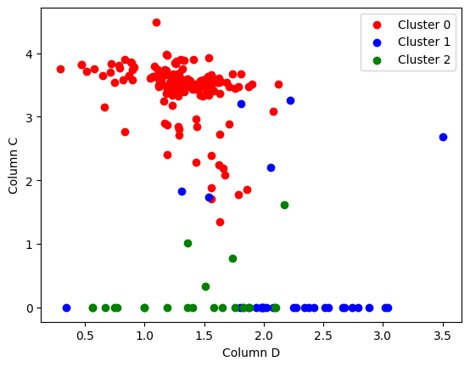
Distribution of Additive C and D
Additive C and Additive D are another additive with low P-value.
By plotting a plot chat, we can notice Cluster 0 has High Value in Additive C and Medium to low value in Additive D.
While Cluster 1 and 2 are usually low in Additive D.
Cluster 1 has high value in Additive D while Cluster 2 has low value in Additive D.

Slide 16
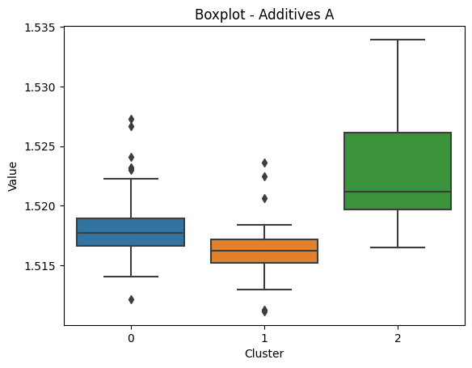
Box Plot for Additive A
Generally cluster 2 has higher value in Additive A compare to other cluster

Slide 17
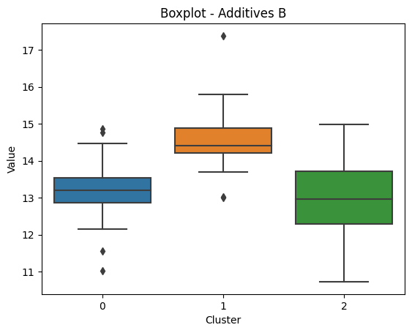
Box Plot for Additive B
Generally cluster 1 has higher value in Additive B compare to other cluster

